Slide 1
Road Accident Analysis Report
Prepared By:
-Taghreed Emad El-Deen Fathy
-Mennatallah Ahmed Abd Elkhalek
-Mohamed Osama Mohamed
Date: February 22, 2025

Slide 2

Introduction
This report provides an extensive analysis of road accidents, identifying key causes, trends, and insights for safety improvements.

Slide 3
Data Collection
The data for this analysis was gathered from various transportation and traffic monitoring sources, including:
Traffic Monitoring Systems: Data on traffic volume, congestion levels, and accident reports were collected from highway sensors and surveillance cameras.
Government & Public Safety Reports: Official reports provided insights into road accidents, fatalities, and injuries categorized by time of day.
Weather Data Sources: Weather conditions affecting traffic patterns were considered, incorporating factors like precipitation, visibility, and temperature.
GPS & Navigation Services: Aggregated data from GPS providers helped analyze travel time variations and peak traffic hours.

Slide 4

Overview
• Top Accident Cause: Drunk Driving (26,506 incidents)
• Top Accident Day: Tuesday
• Top Accident Time: Night
• Top Accident Year: 2002
• Total Fatalities: 263,000
• Total Injuries: Over 1 million
• Top Country by Injuries: Brazil
• Lowest Accident Region: South America
• Lowest Country by Injuries: Russia

Slide 5
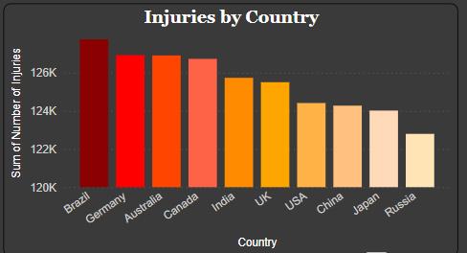
Countries & Region Analysis
Key Findings:
Injuries by Country:
Brazil, Germany, and Australia have the highest number of injuries, exceeding 126K each.
Other countries, including India, the UK, the USA, China, Japan, and Russia, show a decreasing trend in injury numbers.

Slide 6
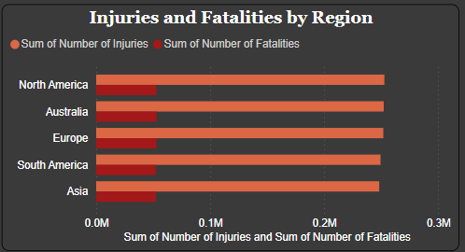
Injuries and Fatalities by Region:
North America has the highest number of injuries, around 252.9K.
Australia follows closely with 252.4K, while Europe, South America, and Asia report slightly lower figures at 252.0K, 249.5K, and 248.4K, respectively.
Fatalities are also plotted, showing a strong correlation between high injury rates and fatalities.

Slide 7
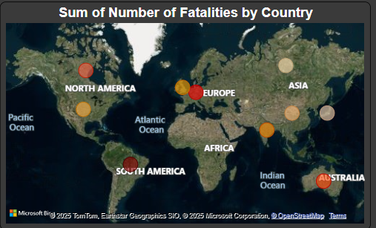
Fatalities by Country:
A geographical distribution highlights accident fatality hotspots across North America, Europe, South America, Asia, and Australia.
The heatmap suggests certain countries face higher risks, necessitating further investigation into causes.

Slide 8
Accidents Date &Times
Key Findings:
Traffic Volume by Time of Day:
The highest traffic volume is observed in the afternoon and morning, with values approaching 5,000 vehicles.
Night and evening also show significant traffic flow but slightly lower than daytime hours.
Traffic Volume by Weather Conditions:
Windy and rainy conditions see the highest average traffic volume, exceeding 5,000 vehicles.
Snowy and clear conditions report moderate levels, while foggy weather records the lowest traffic volume.

Slide 9
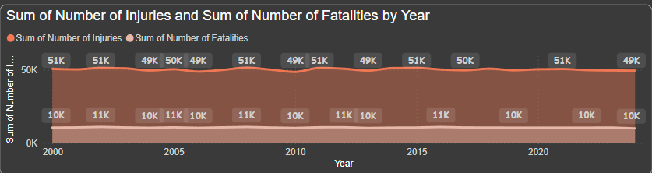
Injuries and Fatalities by Year:
Injury numbers have remained steady since 2000, fluctuating between 49K and 51K per year.
Fatalities have consistently been around 10K per year, showing no significant increase or decrease over the years

Slide 10
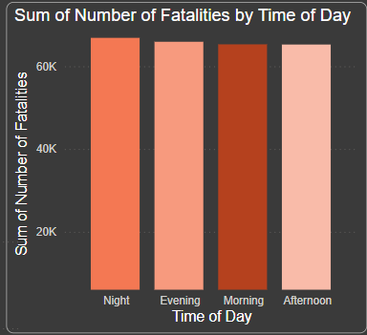
2.Fatalities by Time of Day:
Night, evening, and morning have the highest fatality rates, each around 60K fatalities.
The afternoon has slightly fewer fatalities compared to other times of the day.

Slide 11
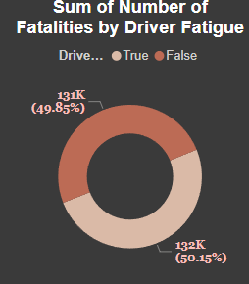
Driver & Vehicle Insights
1. Cyclists Involvement by Driver Age Group
The <18 age group has the highest involvement in cyclist-related accidents, followed by the 18-25 and 26-40 age groups.
Drivers aged 41-60 have significantly lower involvement in such accidents.
Severe accidents contribute the most to fatalities, especially when the vehicle condition is poor.
2. Fatalities by Driver Fatigue
Driver fatigue is a major factor, accounting for approximately 50% of fatalities (132K cases).
Non-fatigued drivers account for the remaining 49.85% (131K cases).
Note:
We expected that when the driver was Fatigue, the number of fatalities would be greater than when the driver was not Fatigue.

Slide 12
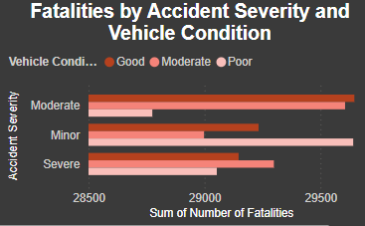
3. Fatalities by Accident Severity & Vehicle Condition
Fatalities are categorized based on accident severity (Minor, Moderate, Severe). Note: We expected that when the severity of the accident is severe, it means that there are a higher number of Fatalities than when the severity of the accident is moderate.

Slide 13
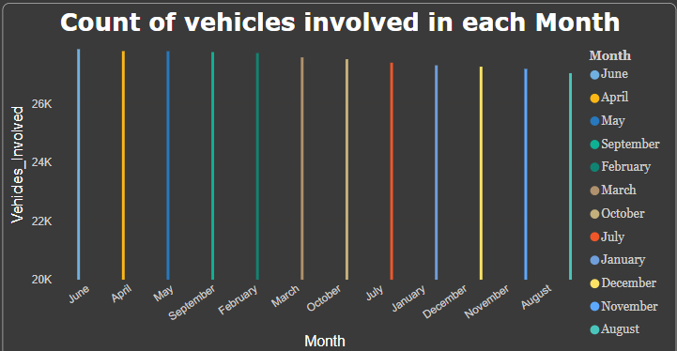
4. Count of Vehicles Involved Each Month
Vehicle involvement remains relatively stable throughout the year, fluctuating between 20K and 26K vehicles per month.
June, April, and May show slightly higher involvement compared to other months.

Slide 14
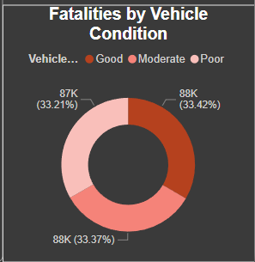
5. Fatalities by Vehicle Condition
Fatalities are evenly distributed across vehicle conditions:
Good Condition: 87K fatalities (33.21%)
Moderate Condition: 88K fatalities (33.42%)
Poor Condition: 88K fatalities (33.37%)
This suggests that vehicle condition alone is not the primary factor influencing fatalities.
Note: When the vehicle is in poor condition, the number of deaths is supposed to be higher than when it is in good or moderate condition.

Slide 15
Key Insights & Recommendations Drivers & Vehicles
✔ Young drivers (<18 & 18-25) are more prone to cyclist accidents—awareness programs and stricter licensing measures could help reduce risks. ✔ Driver fatigue contributes to 50% of fatalities, indicating a need for fatigue monitoring systems and mandatory rest breaks for long-distance drivers. ✔ Accidents occur consistently across all months, meaning safety measures should be reinforced year-round rather than seasonally. ✔ Vehicle condition alone is not the primary cause of fatalities—other factors such as driver behavior, road conditions, and weather should be analyzed further.
This report highlights critical risk factors affecting road safety. Future analysis can focus on driver behavior, traffic regulations, and vehicle technology improvements to minimize accident rates. 🚦

Slide 16
Weather & Street Conditions
1. Injuries by Road Condition
Wet and snow-covered roads have the highest injury rates (317K-314K injuries).
Icy and dry roads have slightly lower injury rates (313K-310K injuries).
This suggests that adverse road conditions significantly contribute to accident injuries.
2. Fatalities by Urban vs. Rural Areas
Urban areas account for 49.66% (131K fatalities).
Rural areas account for 50.34% (133K fatalities).
Despite lower traffic density in rural areas, the higher fatality rate may be due to higher speeds and delayed emergency response times.
3. Key Weather Hazard
Rainy conditions are highlighted as the most dangerous weather condition, contributing to higher accident and injury rates.

Slide 17
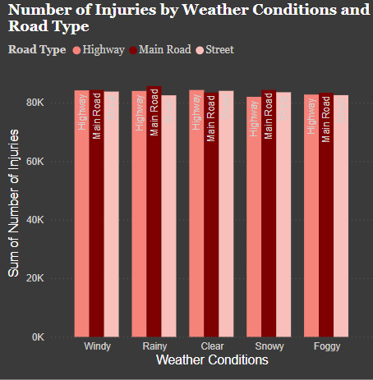
4. Weather Conditions & Road Type Impact on Injuries
Rainy conditions have the highest number of injuries across all road types.
Highways and main roads show consistently high injuries across all weather conditions.
Windy, foggy, and snowy conditions also contribute to significant injury numbers.

Slide 18
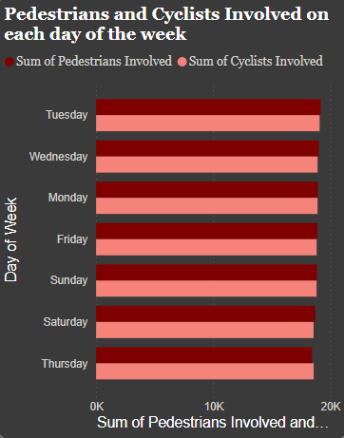
5. Pedestrians & Cyclists Involvement by Day of the Week
Involvement rates are fairly even throughout the week, with Tuesday and Wednesday showing slightly higher numbers.
Weekends (Saturday & Sunday) have almost the same level of involvement as weekdays, indicating that accidents aren’t strictly workweek-related.
Note: The values ​​between the number of pedestrians and the number of cyclists involved are very close.

Slide 19
Causes & Severity
1.Cyclists Involved in Accidents:
Similar numbers across Main Roads, Streets, and Highways.
Major causes: Speeding, Distracted Driving, Drunk Driving, Mechanical Failure, and Weather Conditions.
2.Traffic Volume & Population Density vs. Accident Severity:
Moderate Severity: 222M traffic volume, 110M population density.
Minor Severity: 222M traffic volume, 111M population density.
Severe Accidents: 221M traffic volume, 110M population density.
.
Recommendations
Stricter speed regulations to reduce the 3,400 fatalities from speeding.
Improved road safety measures in snowy & wet conditions to lower injury risks.
Enhancing cyclist safety to mitigate risks across all road types.

Slide 20
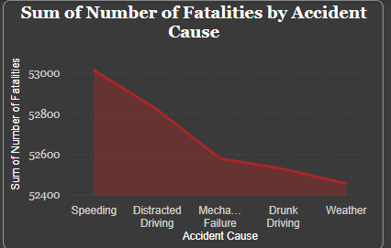
3.Fatalities by Accident Cause:
Speeding: Highest fatalities (3,400).
Distracted Driving & Mechanical Failure: Gradual decline in fatalities.
Drunk Driving & Weather Conditions: Lowest fatality counts.

Slide 21
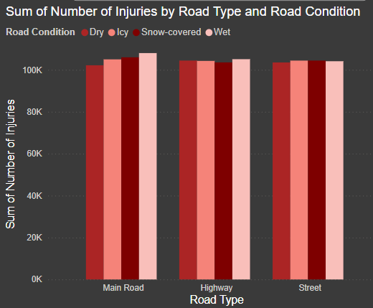
4.Injuries by Road Type & Condition:
Main Roads, Highways, and Streets show similar injury counts (100K).
Snow-covered & Wet Roads slightly increase injury numbers

Slide 22
Emergency &Response Time
Response Time by Accident Severity:
Minor Accidents: 1.43M response time (33.24% of total).
Moderate Accidents: 1.43M response time (33.41% of total).
Severe Accidents: 1.43M response time (33.35% of total).
Average Response Time by Time of Day:
Morning: 32.64 min (highest).
Evening: 32.53 min.
Night: 32.41 min.
Afternoon: 32.39 min (lowest).
Recommendations
Reduce morning response time (32.64 min) to match afternoon levels (32.39 min).
Improve response efficiency in high-injury regions to prevent fatalities.
Enhance emergency resource allocation to ensure balanced response times across all severities.

Slide 23
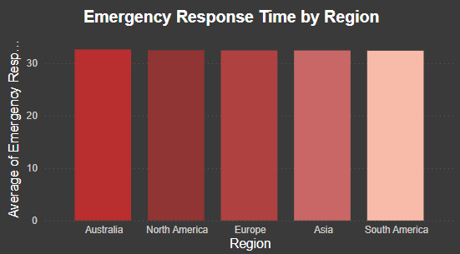
Emergency Response Time by Region
Australia: 32.64 min
North America: 32.5 min
Europe: 32.46 min
Asia: 32.45 min
South America: 32 min
Australia has the highest response time (32.64 min), while South America has the lowest (32.41 min). Other regions have similar response times, ranging between 32-33 min. 🚑

Slide 24
Economic Loss &Medical Costs
Medical Cost & Economic Loss by Region:
Australia: 66.61% Economic Loss, 33.39% Medical Cost.
Europe: 66.53% Economic Loss, 33.47% Medical Cost.
North America: 66.05% Economic Loss, 33.40% Medical Cost.
Asia: 66.87% Economic Loss, 33.13% Medical Cost.
South America: 66.82% Economic Loss, 33.18% Medical Cost.
.Top Country in Economic Loss & Medical Costs:
Canada ranks highest in total economic loss and medical expenses.
Recommendations
Reduce medical costs by improving pre-hospital emergency care.
Enhance insurance coverage policies in high-risk regions.
Implement stricter road safety measures to lower accident-related economic losses.

Slide 25
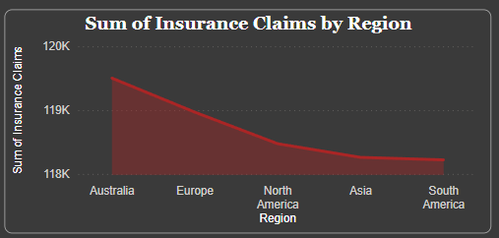
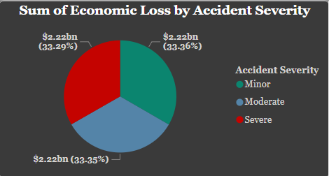
Insurance Claims by Region:
Australia has the highest number of insurance claims (~120K), followed by Europe, North America, Asia, and South America.
Economic Loss by Accident Severity:
Minor Accidents: $2.22B (33.29%).
Moderate Accidents: $2.22B (33.36%).
Severe Accidents: $2.22B (33.35%).
Note: We think Economic Loss To Severe Accidents
more than Moderate and Minor Accidents

Slide 26
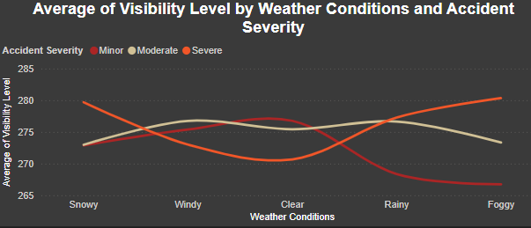
General Insights
Population Density & Traffic Volume by Road Type:
Highest traffic volume recorded on main roads (0.2M) and streets (0.18M), followed by highways (0.15M).
Population density follows a similar pattern.
Average Speed Limit by Accident Severity & Driver Age Group:
Speed limits remain consistent across different accident severities and driver age groups.
Visibility Level by Accident Severity & Time of Day:
Visibility is highest during the afternoon and decreases at night across all accident severities.
Severe accidents show slightly lower visibility levels.
Average Visibility Level by Weather Conditions & Accident Severity:
Foggy and snowy conditions have the lowest visibility levels (≈272-274), while clear and windy conditions show higher visibility (≈276-278).
Visibility trends fluctuate with accident severity.
Recommendations
Improve lighting on roads with high night-time accident severity.
Adjust speed limits dynamically based on weather and time of day.
Enhance road safety on main roads & streets due to high traffic volume

Slide 27
Our Notes
The unusual similarity in data values caused confusion during our analysis. So far, we have not identified the reason behind this consistency, which made it challenging to draw clear conclusions.“
Regional differences were minimal, indicating that accident-related factors were fairly balanced worldwide.
Medical costs consistently outweighed economic losses, highlighting the significant financial burden of injuries.
Weather conditions and time of day had some effect on accidents, but not enough to cause drastic differences in response times or accident severity.
These findings suggest that road safety improvements should focus on systematic enhancements rather than targeting specific regions or conditions.

Slide 28
Recommendations
• Stricter Traffic Regulations: Tougher laws on drunk driving and speeding.
• Public Awareness Campaigns: Educate drivers on road safety.
• Infrastructure Improvements: Enhance road conditions and signage.
• ADAS Technology: Encourage driver assistance systems.
• Improved Emergency Response: Strengthen emergency services.

Slide 29
Conclusion
Drunk Driving is the leading cause of road accidents.
A combination of regulations, awareness, and infrastructure improvements is key to reducing accidents and enhancing safety.

